Slide 1
Rationale
  Use the animation, Course Intro.zip, to show the rationale of the course.

Slide 2


Objectives
In this session, you will learn to:
  Introduce HTML
  Create an HTML Web page

Slide 3
Introducing HTML
A markup language:
  Enables you to create attractive and interactive websites.
  Provides a way to describe the structure of a Web page.
  Specifies the code in the form of tags for defining, processing, and presenting the
  text on Web pages.
  The Web pages can be of the following types:
  Static
  Dynamic

Slide 4
Introducing HTML (Contd.)
The Internet:
  Makes the Web pages and websites accessible to the users.
  Enables the organizations to share and access information.
  Is an interconnected network of computers across the globe.
  The World Wide Web (WWW):
  Is a collection of resources on varied topics that can be accessed through the Internet.
  Is a collection of Web pages that are scattered but interlinked.

Slide 5
Creating an HTML Web Page
Hyper Text Markup Language (HTML):
  Is a versatile markup language that is used to publish information as a Web page.
  Provides tags that help in creating Web pages.
  Allows the creation of hyperlinks to connect the Web pages.
HTML is used to create Web pages using software applications known as editors.
HTML editors are broadly classified into the following categories:
  Text editor
  Graphic editor

Slide 6
Text Editor
A text editor is an application in which the HTML code is written for
creating a Web page.
Notepad and EditPlus are examples of text editors.
The HTML code written inside a text editor is saved with the .htm or .html
extension.

Slide 7
Graphic Editor
A graphic editor enables you to embed an HTML element into a Web page by
using the drag-and-drop functionality.
Dreamweaver is an example of a graphic editor.
  Use the simulation, Dreamweaver.zip, to demonstrate how to create a Web page using Dreamweaver.

Slide 8
Identifying the Basic Structure of an HTML Page
An HTML document is created by using various tags and their attributes.
Tags are markup codes enclosed in angular brackets.
The following HTML tags are referred to as structural tags as they create the
structure of an HTML document:
  <!DOCTYPE HTML>
  <HTML>
  <HEAD>
  <BODY>

Slide 9
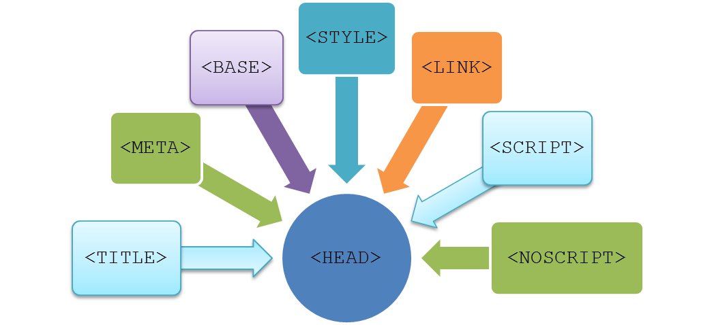
Exploring the <HEAD> Tag
The <HEAD> tag:
  Is contained within the <HTML> and </HTML> tags.
  Is used to define the header of the HTML document.
  Can include the following tags:

Slide 10
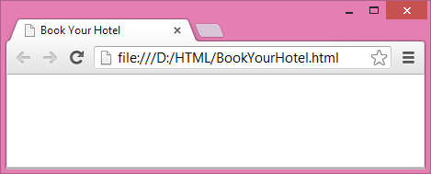
Exploring the <HEAD> Tag (Contd.)
The <TITLE> tag:
  Defines the title of the document.
  Can appear only once in the HTML document.
  For example:
    <HEAD>
    <TITLE> Book Your Hotel</TITLE>
    </HEAD>
    The output of the preceding code snippet is displayed, as shown in the following figure.

Slide 11
Exploring the <HEAD> Tag (Contd.)
The <META> tag:
  Provides additional information about the current document in the form of name and value pairs.
  For example:
    <META name="description" content="This website provides you the benefit of booking rooms in the best hotels of US">
    <META name="keywords" content="hotel, online, booking">
    <META name="author" content="Harry Anem">
    <META http-equiv="refresh" content="30">

Slide 12
Exploring the <HEAD> Tag (Contd.)
The <BASE> tag:
  Specifies a base URL or address for all the related links on a page.
  For example:
  <HTML>
  <HEAD>
  <TITLE> The BASE Tag Example</TITLE>
  <BASE href="d:/Images/"></BASE>
  </HEAD>
  <BODY>
  <IMG src="img1.jpg"/>
  <BR>
  Best Hotels
  </BODY>
  </HTML>

Slide 13
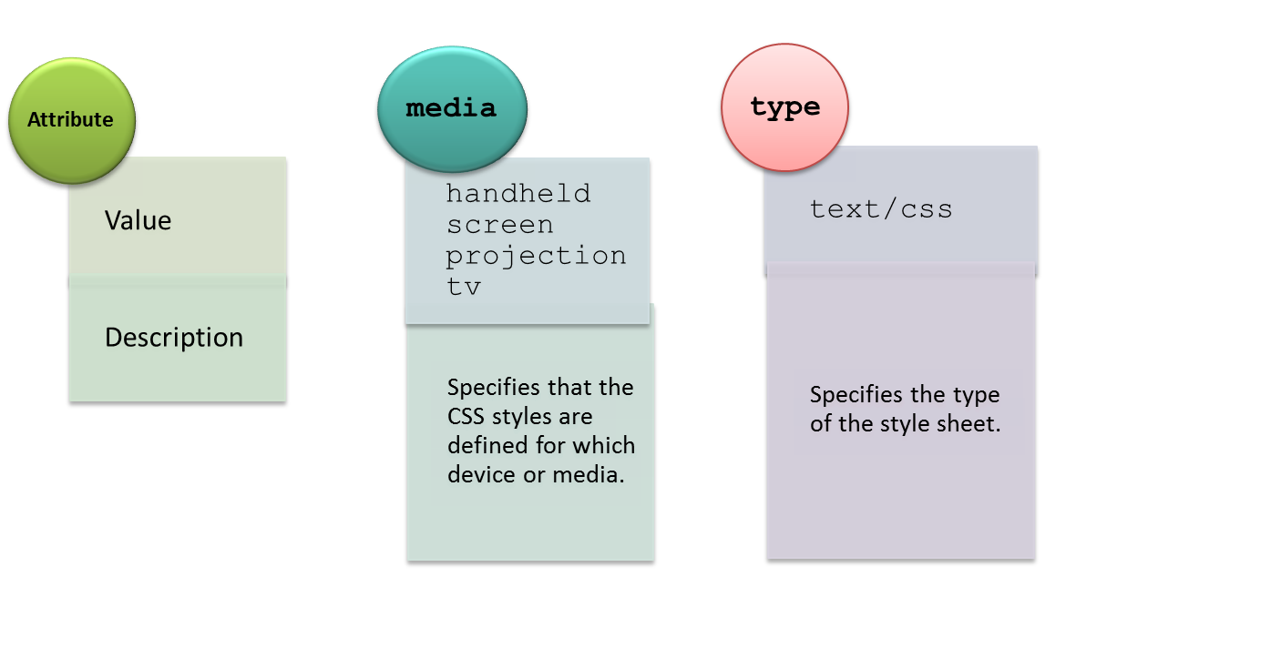
Exploring the <HEAD> Tag (Contd.)
The <STYLE> tag:
  Defines the style information associated with the HTML document.
  Has the following attributes:

Slide 14
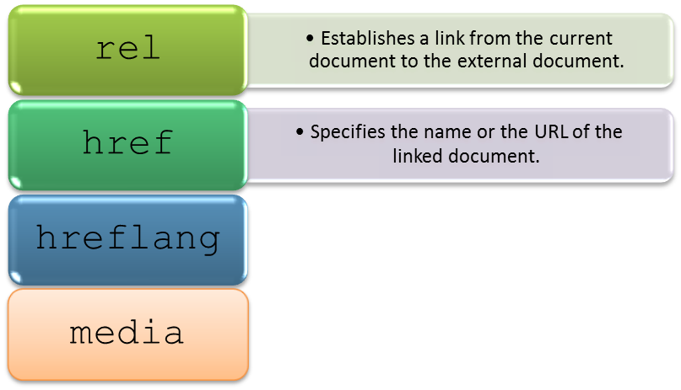
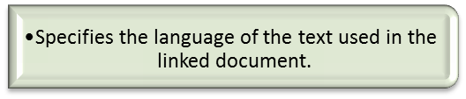
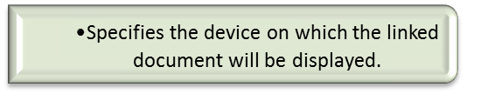
Exploring the <HEAD> Tag (Contd.)
The <LINK> tag:
  Is used to establish the relationship of the current document with other documents in a website.
  Has the following attributes:

Slide 15
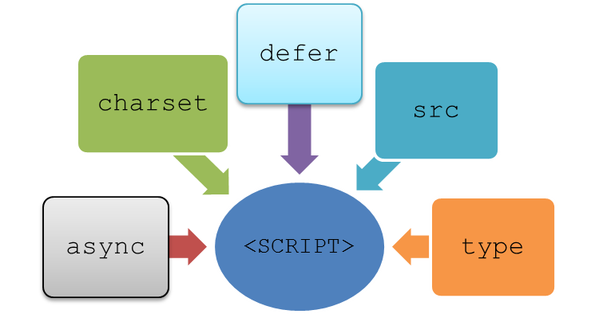
Exploring the <HEAD> Tag (Contd.)
The <SCRIPT> tag:
  Specifies the client-side script, such as JavaScript, associated with the document.
  Has the following attributes:
The <NOSCRIPT> tag displays an alternate content on the browsers on which the scripts have been disabled.

Slide 16
Just a Minute
Which one of the following tags specifies a URL for all related links on a page?
  <BASE>
  <STYLE>
  <LINK>
  <META>

Slide 17
Just a Minute (Contd.)
Solution:
    <BASE>

Slide 18
Exploring the <BODY> Tag
The body section:
  Is the central part of the HTML document required to display content on the Web page.
  Begins with the <BODY> tag.
  Contains the actual visible content of an HTML document.

Slide 19
Exploring the <BODY> Tag (Contd.)
The heading tags:
  Are used to define the headings that specify the main idea of the content.
  Range from <H1> to <H6>.
The paragraphs are added in an HTML document using the following tags:
<P>
<DETAILS>
<SUMMARY>

Slide 20
Exploring the <BODY> Tag (Contd.)
The layout:
  Specifies how various elements or content should be displayed on the Web page.
  Is defined by using the following tags:
<DIV>
<SPAN>

Slide 21
Exploring the <BODY> Tag (Contd.)
The content of a Web page can be formatted by using the following tags:
<B>
<I>
<U>
<LI>
<BR>
<HR>

Slide 22
Exploring the <BODY> Tag (Contd.)
Images are added to a Web page:
  To add an artistic value.
  To enhance its visual appeal.
  In the following formats:
JPEG
GIF
PNG

Slide 23
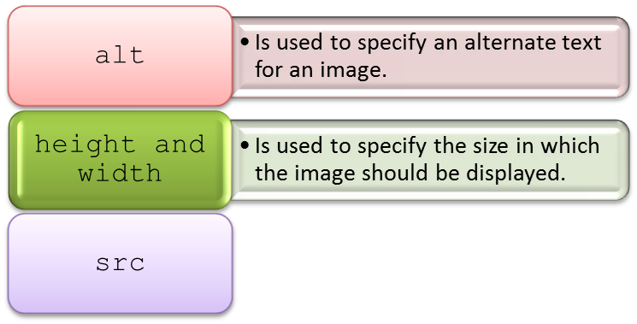
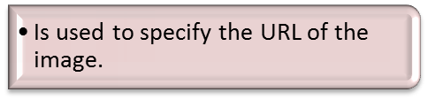
Exploring the <BODY> Tag (Contd.)
  Using the <IMG> tag that has the following attributes:

Slide 24
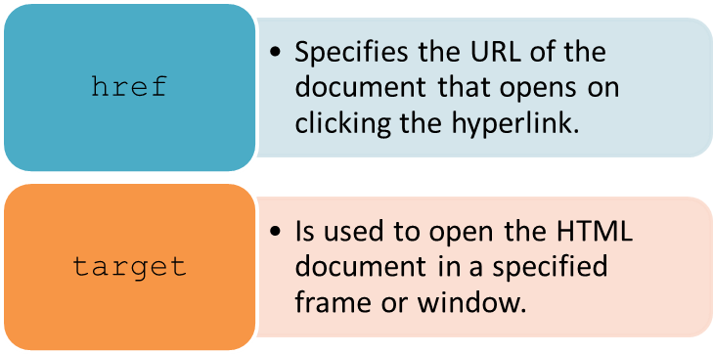
Exploring the <BODY> Tag (Contd.)
Navigation links are added:
  To navigate between the Web pages.
  By using the <A> tag that has the following attributes:

Slide 25
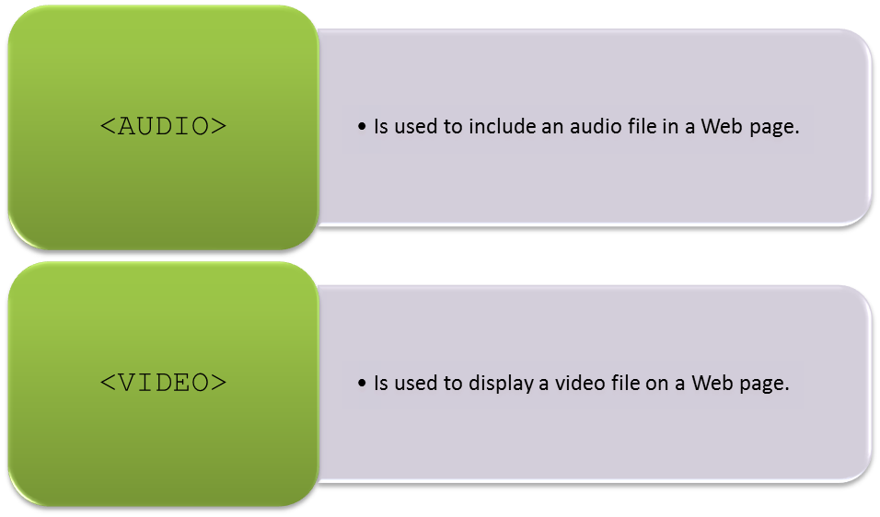
Exploring the <BODY> Tag (Contd.)
The multimedia components are added:
  To embed audio and video in the website.
  To improve the visual effect of the website.
  By using the following tags:

Slide 26



Exploring the <BODY> Tag (Contd.)
Measuring data and displaying a progress bar:
Steve is downloading a file from a website
Saving it in his system

Slide 27
Exploring the <BODY> Tag (Contd.)
Disk space left
While saving the file, Steve wants to view the information about
Level of task completed
These tasks can be done by using the following tags:
<METER>
<PROGRESS>

Slide 28
Summary
In this session, you learned that:
  HTML is a markup language that enables you to create attractive and interactive
  websites.
  Web pages are either static or dynamic.
  An HTML page contains the following structural tags:
    <!DOCTYPE HTML>
    <HTML>
    <HEAD>
    <BODY>
  The following tags are used in the <HEAD> section of an HTML document:
    <TITLE>
    <META>
    <BASE>
    <STYLE>
    <LINK>
    <SCRIPT>
    <NOSCRIPT>
  You can use the following tags to add new paragraphs in an HTML document:
    <P>
    <DETAILS>
    <SUMMARY>

Slide 29
Summary (Contd.)
  To define a layout, you can use the following tags:
    <DIV>
    <SPAN>
  The following formatting tags are used to format the content in an HTML document:
    <B>
    <I>
    <U>
    <LI>
    <BR>
    <HR>
  You can use the <IMG> tag to insert images in a website.
  You can add multimedia elements in a Web page by using the following tags:
    <AUDIO>
    <VIDEO>
  The <METER> tag specifies a scalar measurement within a known range.
  The <PROGRESS> tag is used to display the progress of a task.

